Slide 1



PADDLE PRAIRIE METIS SETTLEMENT HOUSING PROJECT
Adoption of NBC 2020 and Energy Efficiency Tiers for New Home Construction in the Settlement
Liberty Multimedia Inc. (LMI) in collaboration with the Paddle Prairie Metis Settlement Team.
October 24, 2024

Slide 2

PROJECT OVERVIEW
Objective: To build energy-efficient homes for the Paddle Prairie Metis Settlement that meet
sustainability and long-term energy savings goals.
Scope: Seven new homes, including five detached homes and two duplexes (pending Council review and acceptance)
Regulatory Guidelines: Adopting the National Building Code 2020 (NBC) and applying relevant principles from the National Energy Code for Buildings 2020 (NECB).
Energy Efficiency Goals: Achieving Tier 3 energy efficiency for optimal performance, balancing construction costs with long-term energy savings and community well-being.

Slide 3
“This project is part of the NRCan Toward Net-Zero Initiative, which is supporting Indigenous, rural, and remote communities in building energy-efficient homes that align with Canada’s climate goals. Through this initiative, we have secured funding to enhance the energy performance of the new homes being built in Paddle Prairie. Our target is to reach Tier 3 energy efficiency, ensuring that the homes we build today will be sustainable, comfortable, and cost-effective for years to come, while contributing to the reduction of energy usage and utility bills.

Slide 4

PROGRESS SUMMARY: MILESTONES ACHIEVED
  Blueprint for Sustainable Housing: Developed in January 2024, outlining the framework for energy-efficient construction.
  Team Meetings: Regular coordination among key stakeholders, including PPMS, Communitas Group, J.R. Paine and Associates, Sodo EFG Architecture, local Metis Construction Manager Armstrong Builders, and LMI.
  Selected Local Construction Manager: Armstrong Builders, ensuring that local talent is leveraged while meeting energy performance targets.
  Geotechnical Report Completed: Sept 2024. Positive findings confirmed stable land for the housing development.
  Team Collaboration: Local council, contractors, architects, and LMI all working together to meet project goals.
  Project Acknowledgement: Our team has been selected to present at the National Building Technologies and Community Awareness Roundtable hosted by NRCan on October 24, 2024.

Slide 5
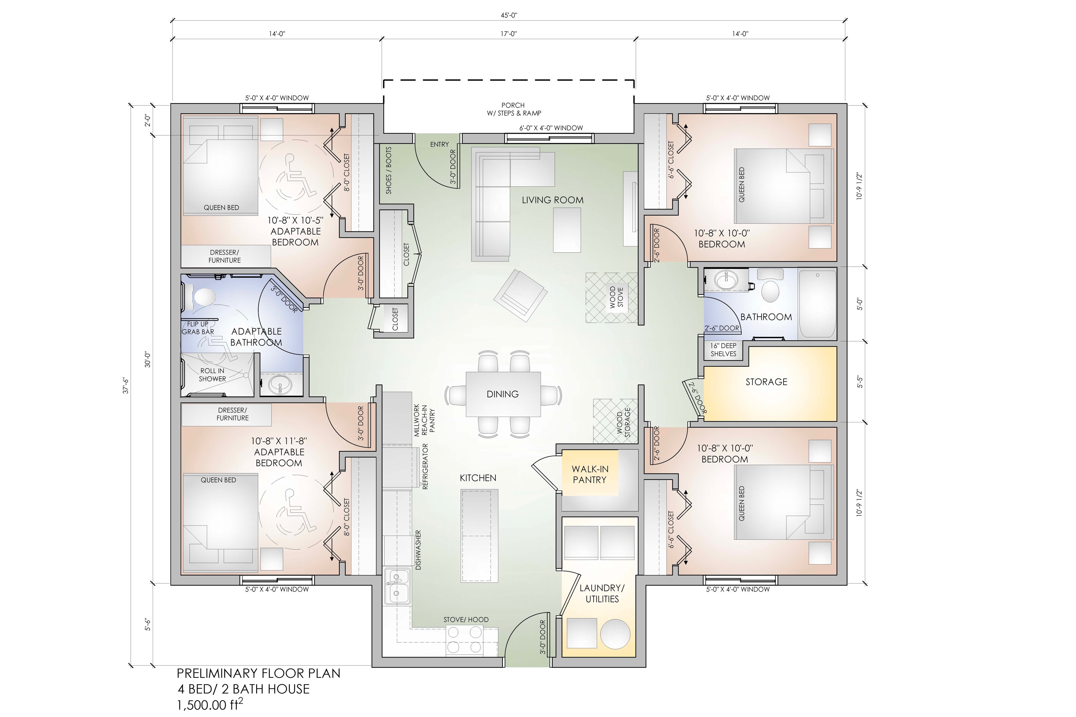
FLOOR PLAN OVERVIEW
Presentation of the Preliminary Floor Plans developed for the project.
Shows the layout of the detached homes and duplexes.
We’ve ensured floor plans align with the accessibility requirements and the adoption of energy-efficient
design principles.

Slide 6

INTRODUCTION TO ENERGY EFFICIENCY
ENERGY EFFICIENCY DEFINITION:
The ability to use less energy to provide the same service or obtain the same result.
WHY ENERGY EFFICIENCY MATTERS:
o Reduces energy bills.
o Lowers carbon emissions.
o Improves indoor comfort and air quality.
o Contributes to long-term sustainability goals.

Slide 7
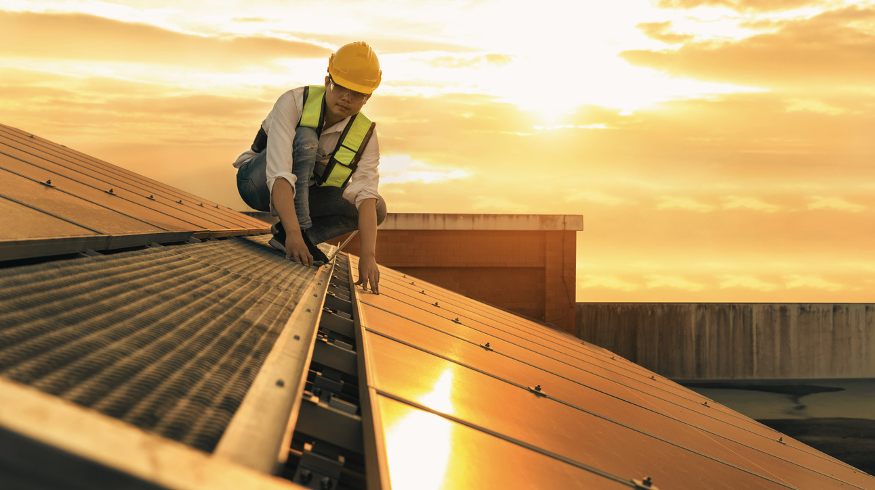
ENERGY EFFICIENCY TIERS OVERVIEW
TIER 1
Baseline compliance with the minimum energy efficiency requirements.
TIER 2
Offers a 15-20% improvement in energy performance compared to Tier 1.
TIER 3
More advanced energy efficiency with a 25-30% improvement, including improved insulation, HVAC systems, and more efficient windows..
TIER 4
Significant improvement (40-50%) with renewable energy systems like solar panels and advanced energy management systems.
TIER 5
Net-Zero Ready. Homes produce as much energy as they consume, representing the most ambitious energy efficiency target.

Slide 8


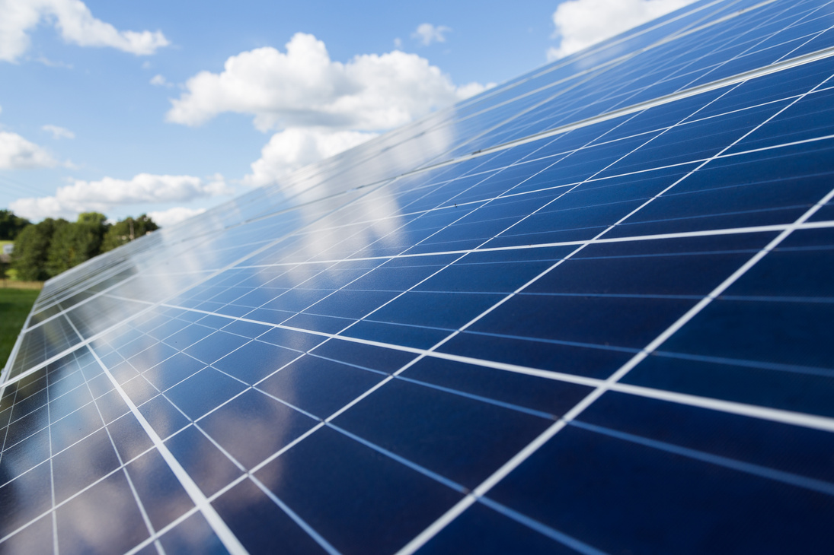
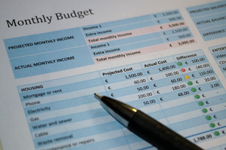
RECOMMENDATION: TIER 3 ENERGY EFFICIENCY
COST-BENEFIT BALANCE:
Tier 3 offers a balance between upfront construction costs and long- term energy savings.
25-30% ENERGY IMPROVEMENT:
Significant energy savings over the life of the home.
CONSTRUCTION PRACTICES:
Advanced insulation, air-sealing, and HVAC systems.
FINANCIAL IMPACT:
Fits within the current budget without requiring renewable energy systems.
COMMUNITY IMPACT:
Lower utility bills and increased comfort for residents.

Slide 9
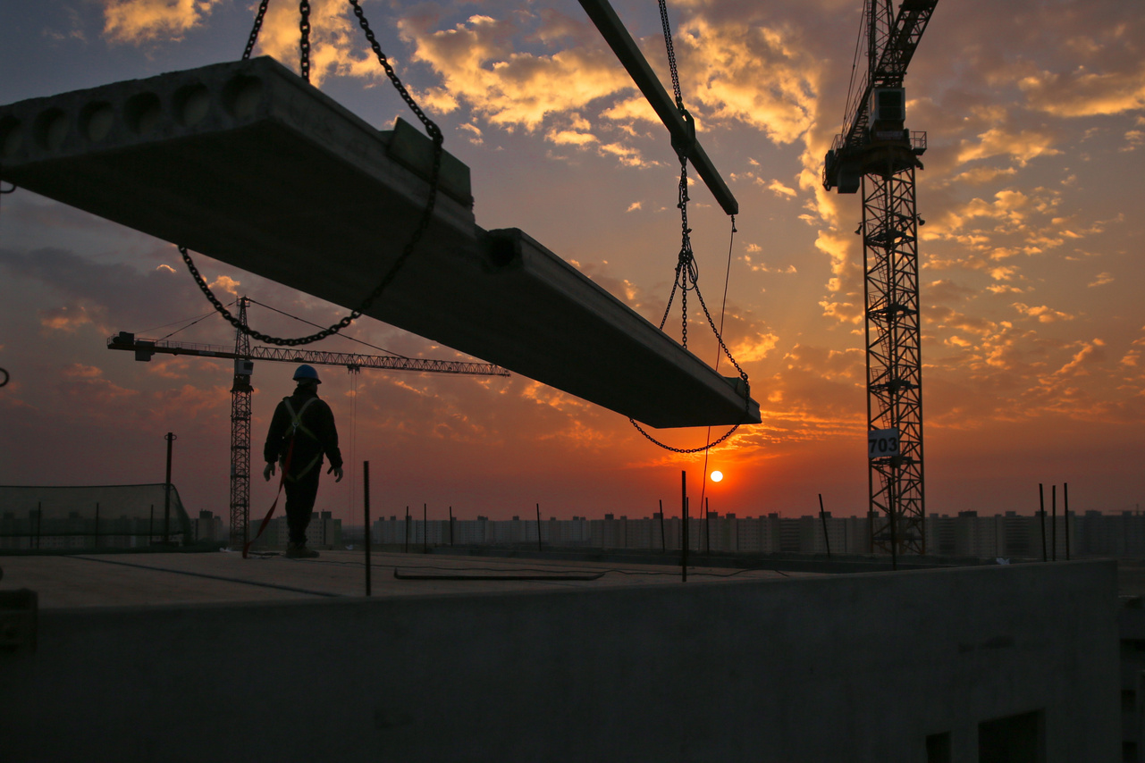

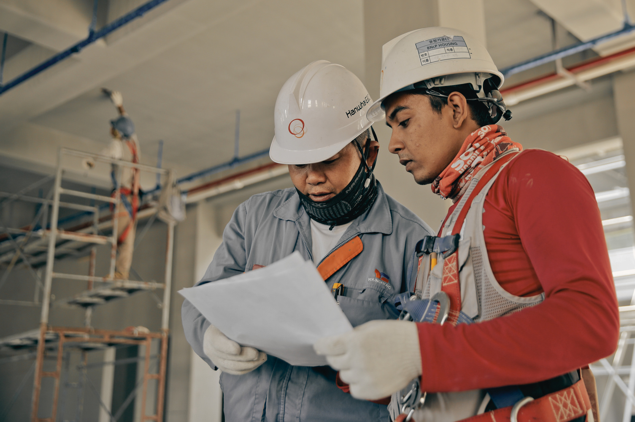
TIER 3 CONSTRUCTION PRACTICES
  Advanced Insulation Techniques (e.g., double-wall construction).
  High-Performance Windows and Doors (triple-glazed for better thermal performance).
  Efficient HVAC Systems (high-efficiency heat pumps).
  Airtight Building Envelopes to reduce heat loss and improve indoor air quality.

Slide 10

EXCLUSION OF RENEWABLE ENERGY SYSTEMS FOR PHASE 1
  Cost Considerations: Due to budget limitations, renewable energy systems like solar panels will not be integrated at this stage.
  Future Opportunities: There is potential for including them in future phases or projects.
  Focus on Building Envelope: Maximizing energy efficiency through construction practices and mechanical systems.

Slide 11


MEET THE PROJECT TEAM
  Communitas Group: Housing development partners and construction oversight.
  Paddle Prairie Metis Settlement: Provides strategic direction and oversight, ensuring the new homes meet community needs and align with the Settlement’s vision for sustainable development.
  Armstrong Builders: Local Metis-led construction management.
  J.R. Paine and Associates: Geotechnical engineering and site assessment.
  Sodo EFG Architecture: Architectural design and compliance with NBC 2020.
  Liberty Multimedia Inc. – Project communications, grant writing, reporting requirements, and are energy efficiency advisors.

Slide 12
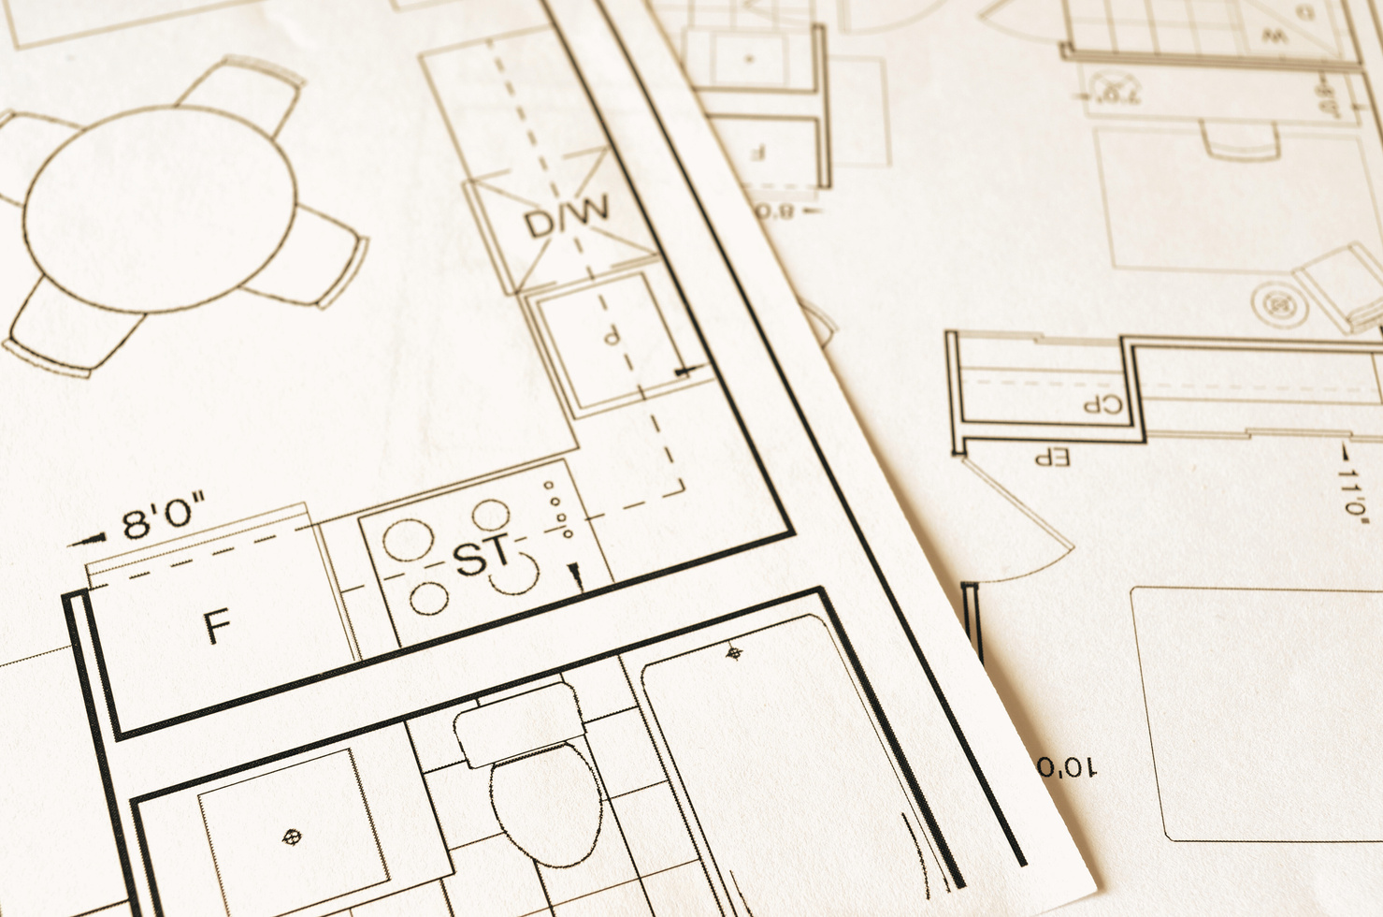

SUMMARY OF GEOTECHNICAL FINDINGS
KEY RESULTS
Positive soil stability across planned housing lots.
IMPACT ON DESIGN:
Recommendations integrated into floor plans and foundation designs for better long-term durability.
NEXT STEPS:
Final adjustments to foundation designs based on detailed geotechnical input.

Slide 13
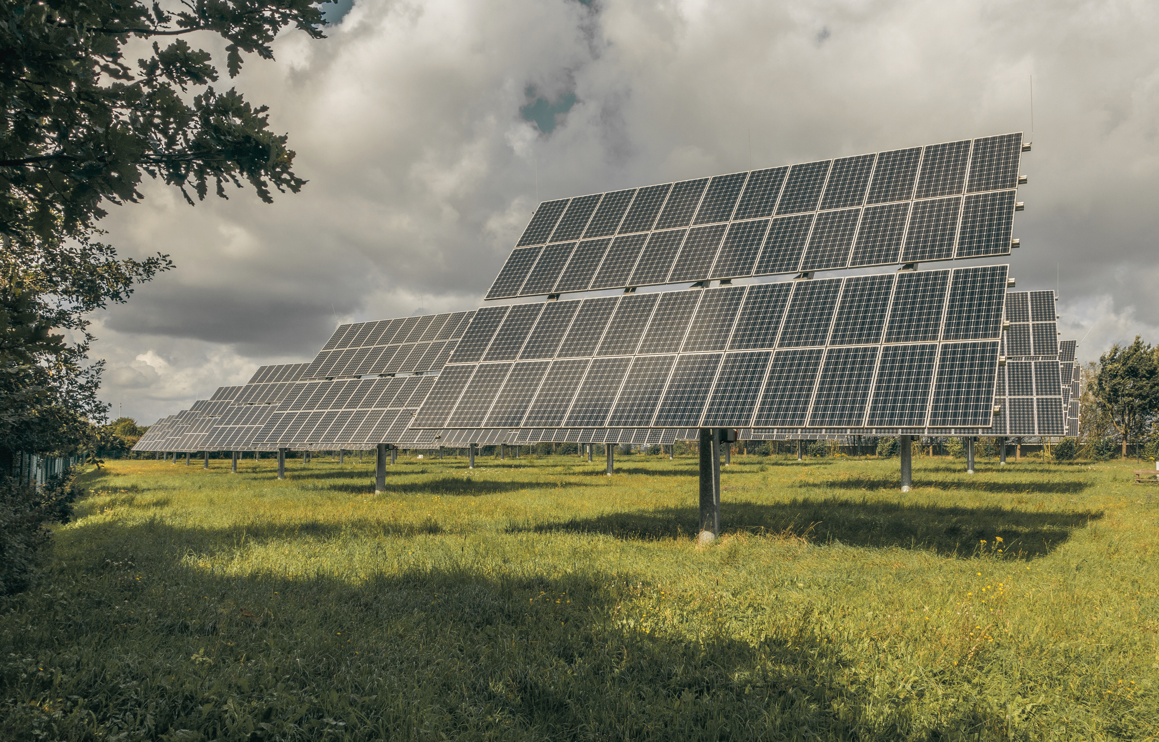
OVERVIEW OF BUILDING CODES
NBC 2020 (NATIONAL BUILDING CODE):
o Focuses on structural safety, fire protection, and accessibility for small buildings.
o Particularly relevant for our project due to its application to residential homes.
NECB 2020 (NATIONAL ENERGY CODE FOR BUILDINGS):
o While primarily for larger buildings, some best practices are being adopted into our project.

Slide 14
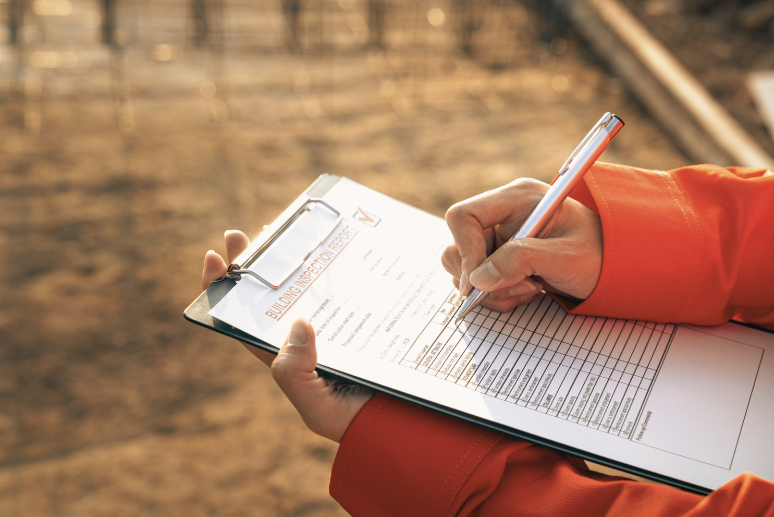
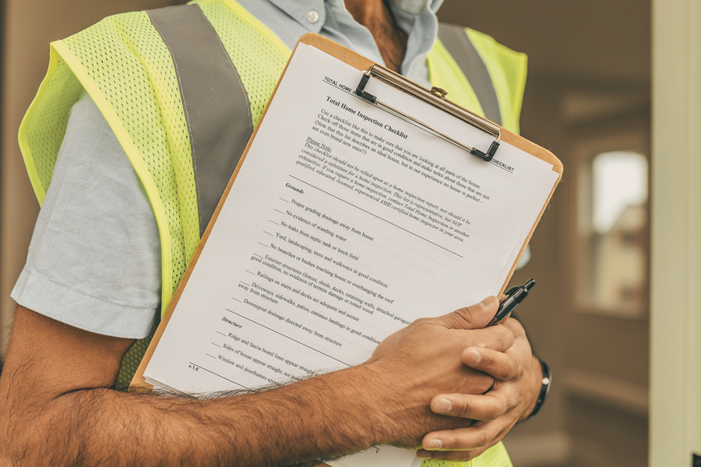

COMPLIANCE WITH NBC 2020 AND NECB 2020
INSPECTION AND CERTIFICATION:
Required steps to ensure compliance with NBC 2020.
ENERGUIDE RATINGS:
Certification process for energy performance assessments.
EXTERNAL EXPERTS:
Role of external experts like Acacia Engineering in verifying energy efficiency compliance.

Slide 15
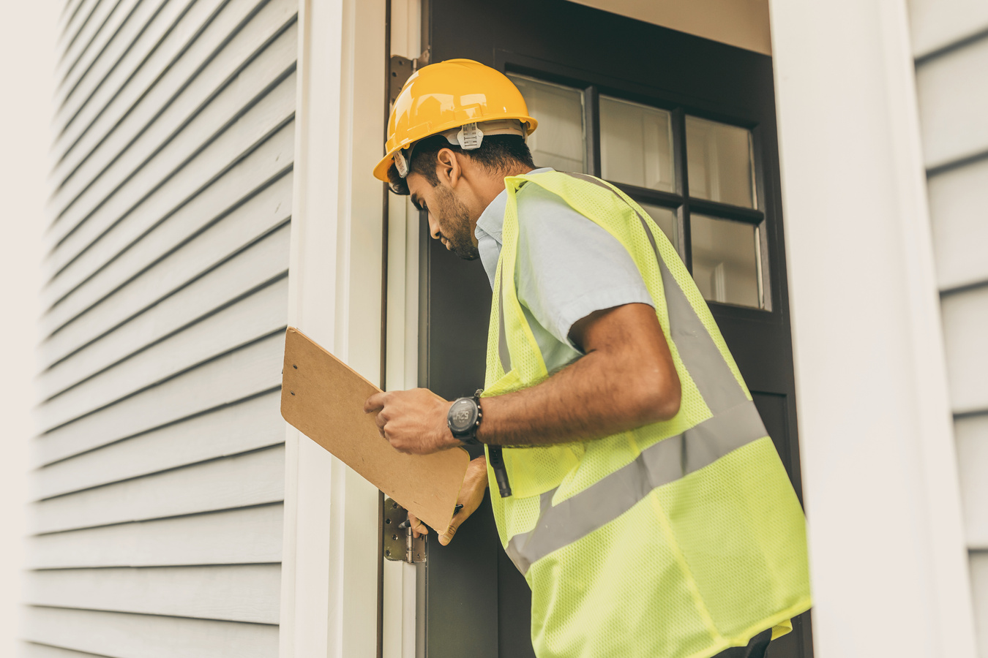
NBC AND NECB ADOPTION ROADMAP
PHASE 1:
Site preparation and foundational work.
PHASE 2:
Structural framing and insulation based on Tier 3 guidelines.
PHASE 3:
HVAC and mechanical system installations.
PHASE 4:
Final inspections, EnerGuide ratings, and certifications.

Slide 16
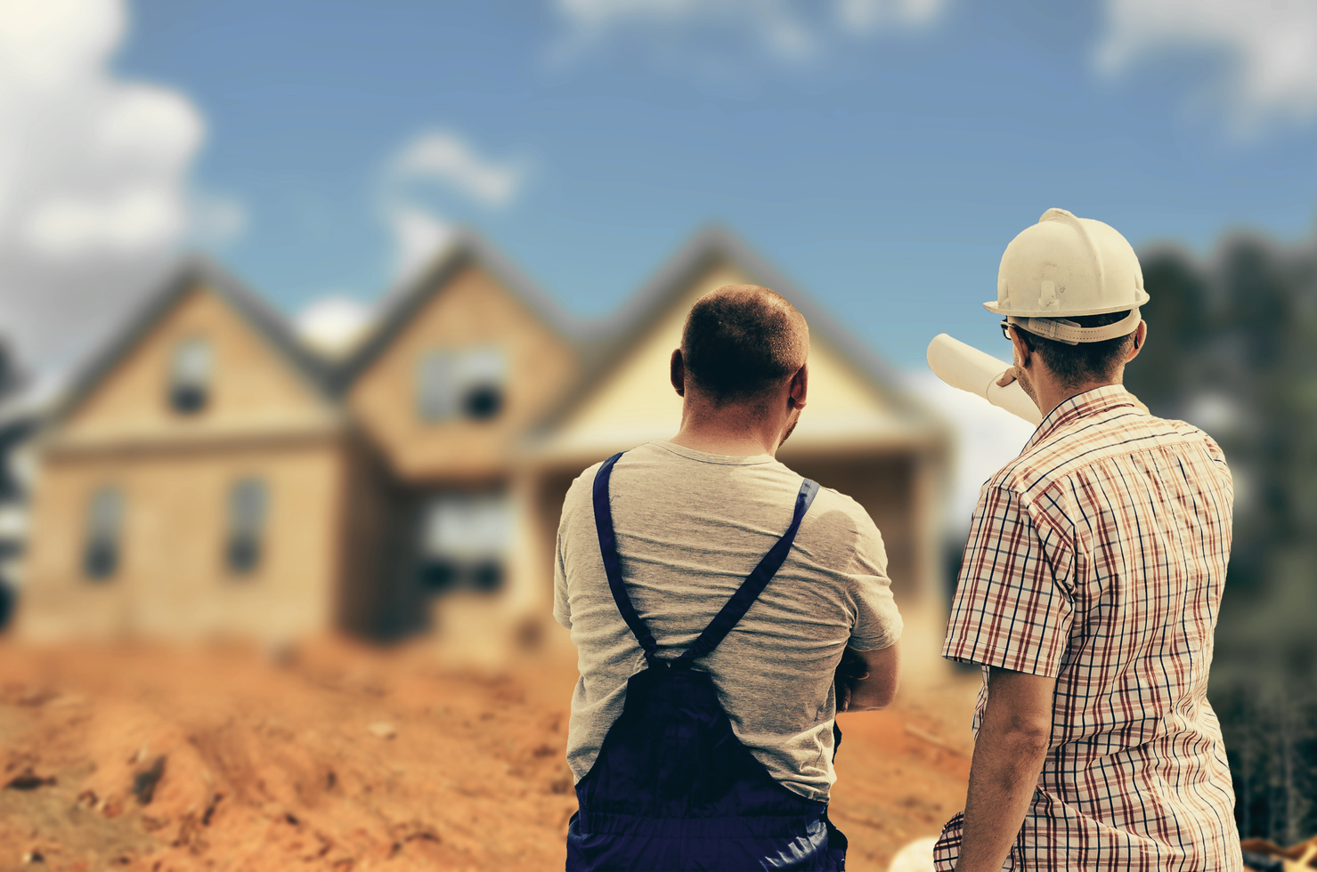
CAPACITY BUILDING FOR THE LOCAL WORKFORCE
  Training Focus Areas:
Building science fundamentals, energy-efficient construction, and HVAC systems.
  Partnerships:
Collaborate with local educational institutions for workforce training.
  Job Creation:
Promoting long-term sustainability and economic development by building local skills.

Slide 17

LEARN MORE ABOUT ENERGY EFFICIENCY

Slide 18
PROJECT TIMELINE AND NEXT MILESTONES
September 2024:
Finalize floor plans and move forward with construction preparations.
July 2025:
Completion of the first phase of construction and post-construction audits.
October 2024:
Present at NRCan Roundtable and begin construction. Unveil www.metisenergyfuture.com

Slide 19

CONCLUSION AND NEXT STEPS
  Our team is committed to sustainability and energy efficiency through the adoption of NBC 2020 and Tier 3 standards.
  Building homes that contribute to long-term energy savings, environmental responsibility, and improved community well-being.
  This collaboration with PPMS & NRCan is creating create a model for resilient, innovative housing.
  Focus on creating a lasting impact on the quality of life for current and future residents.
Next Steps:
  Finalize construction details (October 2024).
  Begin site preparation and construction (Spring 2025).
  Continue community engagement and local workforce training initiatives.
  Complete first phase of construction and post-construction audits (July 2025).
  Explore opportunities for future renewable energy integration in subsequent phases.

Slide 20

THANK YOU!

